Slide 1


Yayasan Rumah Energi
Give People Power

Slide 2

Vision, Mission
Give People Power
V : Indonesia resilience in food and energy
M : Engaging People Towards Shared Renewable Energy Innovation and Knowledge

Slide 3
Fossil Fuel Production and Consumption in Indonesia
Indonesia is major producer of fossil fuels. The word’s largest exporter of coal by weight, a leading exporter of natural gas, till 2004 was an oil exporter. At current rates of extraction, Indonesia oil’s reserves are expected to last about 11 years, coal 14 years, natural gas 40 years (US Energy Information Administration 2013, LEMIGAS, 2012)
Indonesia primary energy demand was doubled from 1990 – 2008, fossil fuels account for 71% (petroleum 30%, coal 22%, natural gas 19% , US EIA 2013, traditional biomass and renewable comprise 29% of energy consumption for residential in remote communities that lack access to distribution networks.

Slide 4
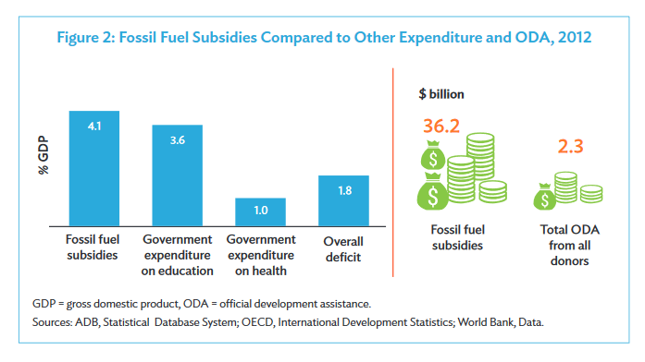
Fossil Fuel Subsidies

Slide 5
Indonesia Energy Subsidy Review- IISD Volume 1 and 2
2013 –
IDR 199,9 trillion petroleum product subsidy
IDR 100,0 trillion electricity subsidy
Make a total of IDR 299,9 trillion ∞ 2.5% GDP and 25% of total government expenditure.
2014 –
Government budgeted IDR 282.1 trillion for total energy subsidy
2015
Government previous budget for subsidy is IDR 276.0 triilion
Planned to save budgeting for IDR 195 trillion by cut off the premium subsidy + “fixed” subsidy for solar IDR 1000 below market price
Resulting in increasing IDR 190 trillion budget for infrastructure = IDR 290 trillion

Slide 6
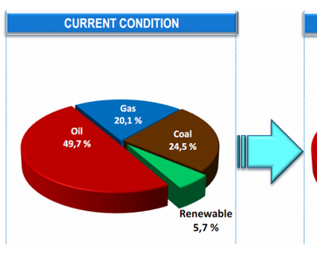
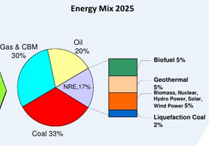
Renewable Energy in 2025
Based on Presidential Decree No 5 2006

Slide 7
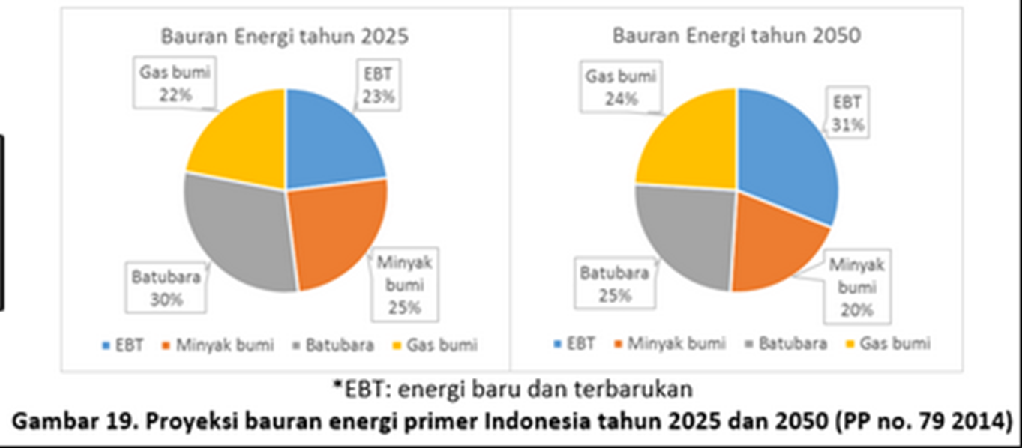
Renewable Energy in 2025

Slide 8
Renewable Energy Sector Development
- Enabling Environment
- Supply Sides
- Demand Sides

Slide 9
Sector Biogas – the Milestone
*
* Projection of 1% domestic biogas contribution for energy mix

Slide 10
BIRU/IDBP* Lesson Learnt
INDONESIA DOMESTIC BIOGAS PROGRAM
More than 20,000 digesters in 2016, equal to 60,000 MT CO2 emission reduction

Slide 11

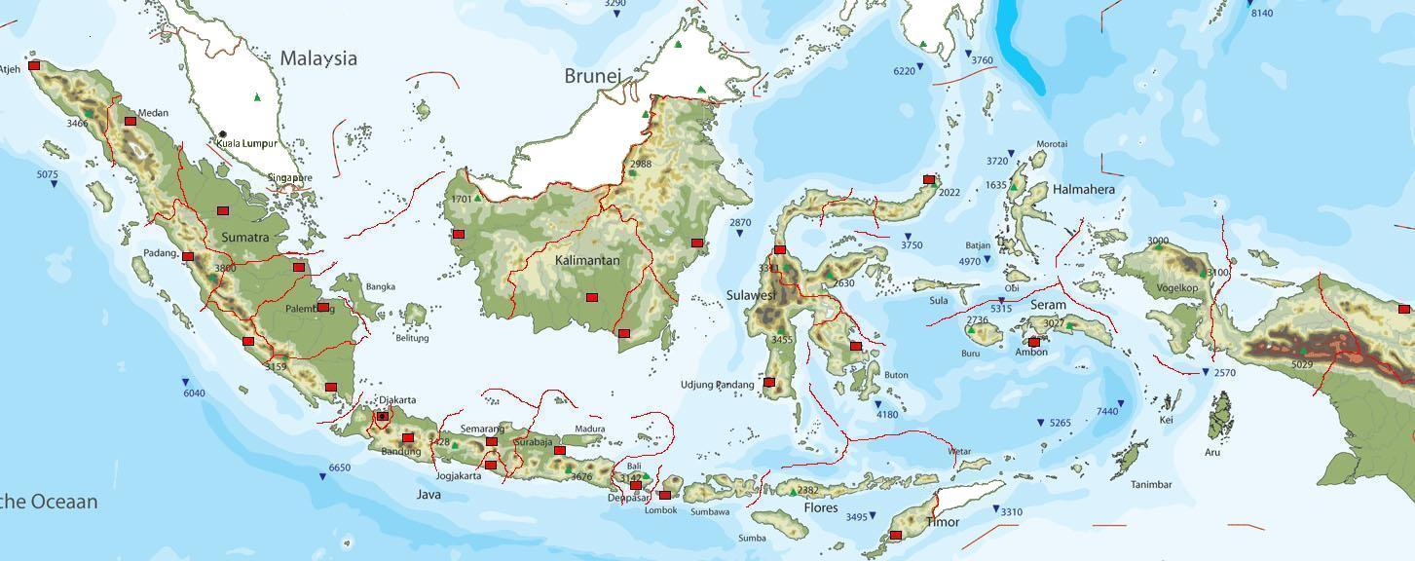

BIRU DIGESTERS in Indonesia

Slide 12
Biogas Sector Development
BIRU/IDBP* experience
- Standardized (SNI) civil construction
CPO (Construction Partners Organization – Renewable Energy Companies) establishment
Quality assurance – 97% functioning
Biogas users contribution – subsidy is limited /Commercial
Side business – bio slurry

Slide 13
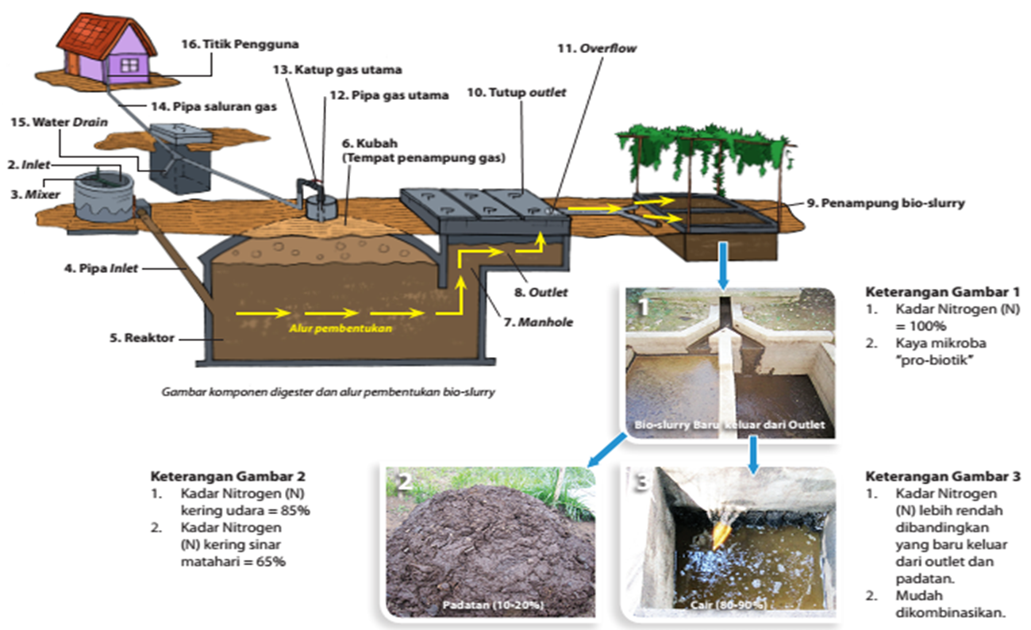
Bio slurry – biogas waste

Slide 14
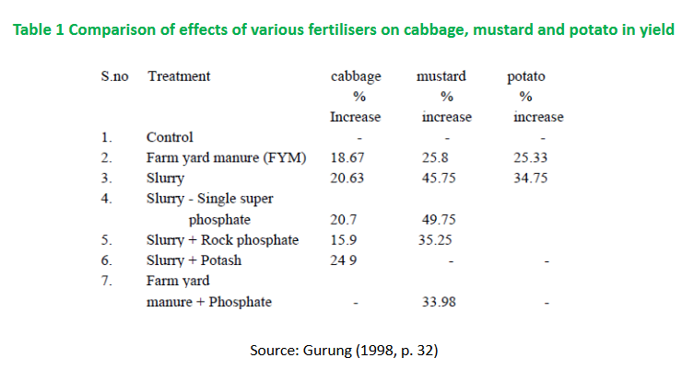
Bio slurry – Supreme fertilizer

Slide 15
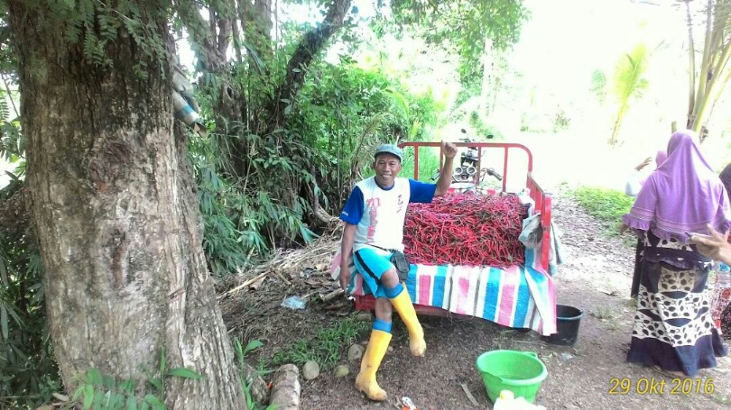
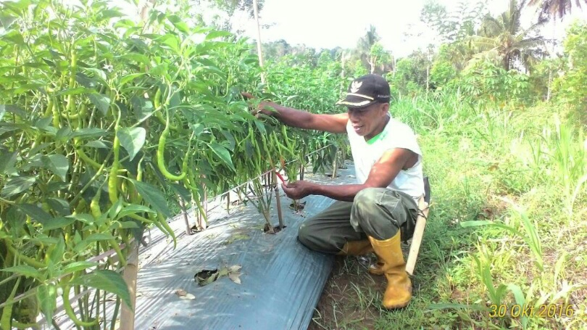
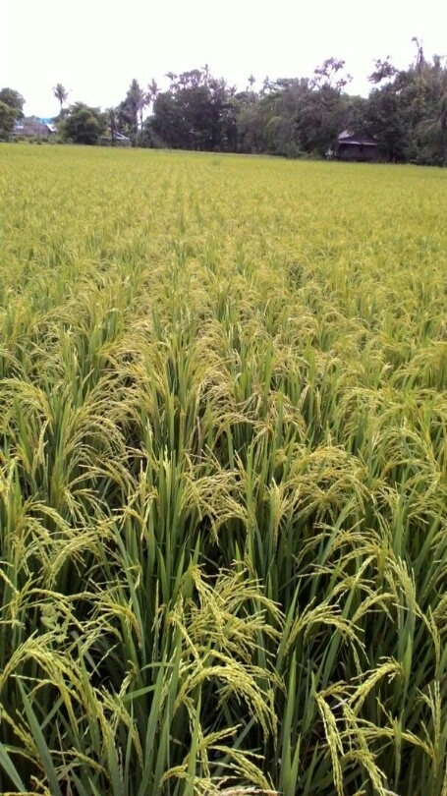
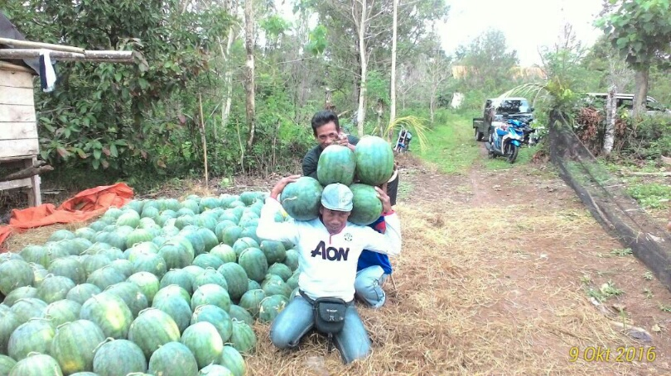
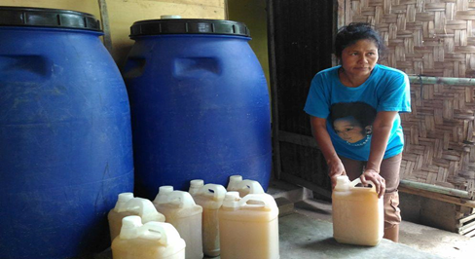
Bio Slurry impact to Crops

Slide 16
RESCO
Renewable Energy Service Company
Sumba pilot
Rationale
Indonesia solar pv market is less than 0.1% in 2016 (Canadian Solar – resource person)
Solar pv installation is still hit and run
Expor import MCB is already available – PLN users can have a benefit by installing solar pv

Slide 17
FGD Topic
Pengentasan kemiskinan energi di Indonesia dan bagaimana peran generasi millennial dalam membantu penyelesaiannya
Membahas isu-isu sustainability seperti diversifikasi, konservasi dan efisiensi energi serta peran anak muda dalam konteks-konteks tersebut

Slide 18
What millennials can do ??
Attitude towards Energy (conserve, green style)
Mastery the technology (relatively easy, and can be small scale)
Be Entrepreneurial – take part in Renewable Energy Business (IPPs) eg. - EBTKE target 6400 MW PLTS in 2025

Slide 19
References
1. Fossil fuel subsidies in Indonesia, Trends Impacts and Reform, ADB 2015
2. Indonesia Energy Subsidy Review , IISD Volume 1 and 2
Article (14 June 2016) : EBTKE - 45,000 MW untuk mencapai 23% bauran di tahun 2025

